Slide 1
Consideration of the report of the chair
of the Hydrological Assembly
Dr Jan Danhelka
Chair, Hydrological Assembly
29 May 2023

Slide 2
Contents
Draft Resolution 4/1 – Review and implementation progress of the Plan of Action associated to the WMO vision and Strategy for Hydrology
Draft Resolution 4/2 – Consideration of Hydrology in WMO Governing bodies and use of the term “water services”
Draft Resolution 4/3 – Regional implementation plans for WMO Hydrological Status and Outlook (HydroSOS)
 | 2

Slide 3
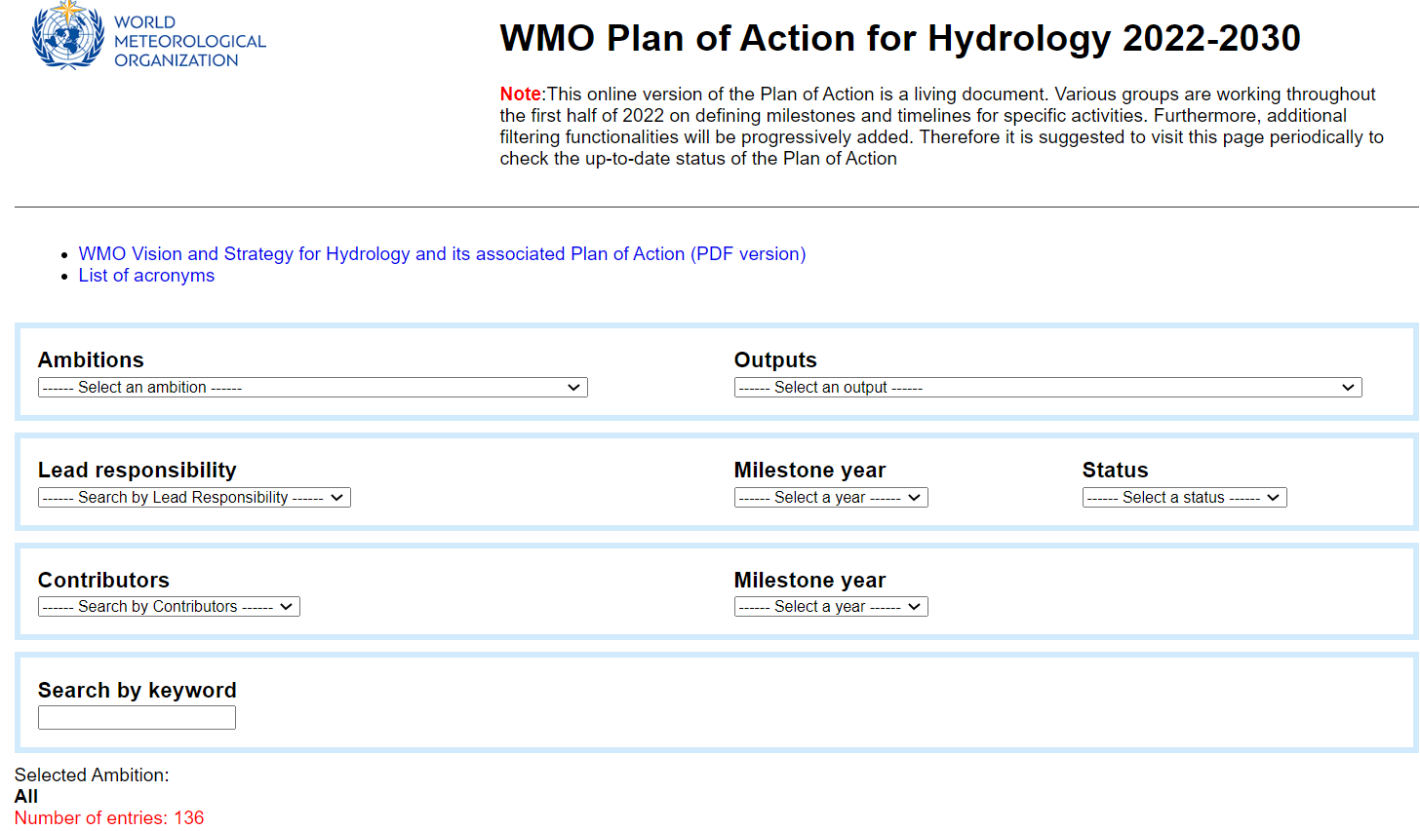
4/1 – Review and implementation progress of the PoA associated to the WMO vision and Strategy for Hydrology
Resolution 4 (Cg-Ext(2021), WMO vision and Strategy for Hydrology and its related Plan of Action (PoA) sets the hydrology related activities for 2022-2030
Decision 2 (EC-76), Approved a proposed distribution of responsibilities of the implementation of PoA based on Hydrological Coordiation Panel (HCP) advice
developed online “living document” version of PoA to facilitate the use of PoA
HCP to monitor and update on a yearly basis the advancements of PoA’s implementation
 | 3

Slide 4
4/1 – Review and implementation progress of the PoA associated to the WMO vision and Strategy for Hydrology
The amendment methodology to WMO PoA for Hydrology
1) Minor Changes – HCP is fully responsible based on feedback from implementing lead
entities (i.e. editorial changes, indication of contributors/partners, etc)
2) Moderate Change – Lead entity suggests the change, HCP assess its consistency within
PoA, Lead/Proposed entity changes its workplan, HCP includes the changes to PoA
(i.e. Changes of Milestones, activity end-date, success criteria, etc)
3) Substantive Changes – Lead entity suggests the change, HCP considers the changes and issues a recommendation to EC, Hydrological Assembly issues a recommendation to Cg
(i.e. change oat the output level)
Decision 5 (EC-75), Request to map proposed Water Climate Coalition (WCC) activities to the WMO Plan of Action (PoA) to accelerate the ongoing activities of technical commissions
WMO PoA for Hydrology activities identified as synergistic with WCC work plan (listed in SERCOM-2/INF. 9.2 and INFCOM-2/INF. 4.3)), WCC will add value by increasing outreach and impact of, and potentially mobilizing resources for, the implementation of PoA
Congress notes the report of the Hydrological Assembly and its recommendations
 | 4

Slide 5
4/2 – Consideration of Hydrology in WMO Governing bodies and use of the term "water services"
Status and Needs
A decrease in attendance of hydrologists in technical commissions due to a reduction in visibility of the hydrological topic; the number of Members attending the former Commission for Hydrology was constantly 50-60, in the 2022 sessions of INFCOM and SERCOM the number of Members having a hydrologist in their delegations was only about 20-25
Few agenda items specifically on hydrology, the lack of awareness that many other documents address transversally meteorological, climatological and hydrological topics, and the difficulties for national hydrology experts to be authorized to attend a session whose relevance for hydrology does not appear clearly from its agenda
Requests presidents of TCs, RAs and WMO to organize the agenda of sessions and name the relevant documents to highlight the relevance for hydrology
Requests the Secretary-General to emphasize in the letters to Members for technical commissions sessions the value to Members of the attendance of hydrologists, encourage Members considering the composition of their delegations
 | 5

Slide 6
4/2 – Consideration of Hydrology in WMO Governing bodies and use of the term “water services
Resolution 24 (Cg-18) the nomination of Hydrological Advisers of Members become mandatory
Regulation 135 the Regional Presidents should be assisted by a Regional Hydrological Adviser (RHA)
In current institutional framework, the only role left without a formal figure to assist in hydrology related matters is the President of the Organization
To establish the role of a Hydrological Adviser for the President of the Organization;
To assign such role to the elected Chair of the Hydrological Assembly;
To modify the wording of Regulation 135 (b) as follows: “The president of an association shouldshall be assisted by a regional Hydrological Adviser; and
requests the Secretary-General to ensure appropriate consultations with Regional Hydrological Advisers and Hydrological Advisers in preparation of activities, conferences, trainings, management group meetings agendas and selection of participants
 | 6

Slide 7
Hydrological
Services
Water Services
As per Article 2 of its Convention WMO has a mandate to facilitate worldwide cooperation in the establishment of networks of stations for the making of meteorological, hydrological and other geophysical observations related to meteorology, to promote the establishment and maintenance of systems for the rapid exchange of meteorological and related information
To promote standardization of meteorological and related observation and activities in operational hydrology considering issues related to weather, climate and water.
common use of the term “water services” usually refers to the supply of potable or non-potable water and sanitation
Do not fall in the remit of WMO mandate
Dealt with by other UN organizations (the Food and Agriculture Organization (FAO), the United Nations Children’s Fund (UNICEF), the World Health Organization (WHO), etc.)
“hydrological services”, better reflecting WMO mandate on operational hydrology
- Preparation and editing of constituent bodies sessions documentation and other official WMO communications in properly representing the mandate of WMO in the domain of hydrology by using “hydrological services” rather than “water service”
 | 7

Slide 8
4/3 – Regional implementation plans for the WMO Hydrological Status and Outlook System (HydroSOS)
Resolution 5 Cg-Ext(2021), operationalizing the global WMO Hydrological Status and Outlook System (HydroSOS) through regional implementation plans led by the regional associations
Developed the HydroSOS Regional and National implementation plans (annex to Cg-19/INF 2.6) by Regional Hydrological Advisors (RHAs) with regional hydrological groups, the HydroSOS technical/implemenation teams
Requests INFCOM to strengthen its activities related to HydroSOS and consider the infrastructure requirements for implementation of HydroSOS;
Requests SERCOM to keep support HydroSOS implementation to the outlook components at different spatial and temporal scales;
Requests the Secretary-General to enhance the Secretariat support towards the implementation of HydroSOS and to work with relevant partners to synergize efforts and secure funding to resource the implementation of HydroSOS; and
Invites Members to contribute to the implementation of regional HydroSOS plans.
 | 8

Slide 9
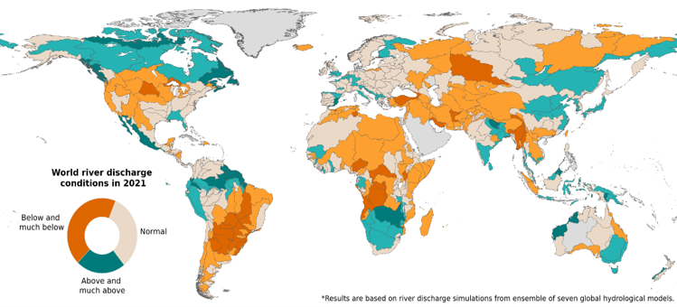
4/3 – Regional implementation plans for the WMO Hydrological Status and Outlook System (HydroSOS)
The establishment of the Steering Committee
- To oversee and support the production of the State of Global Water Resources report,
- To increase WMO operational hydrology activities visibility for policy makers, and
- Demonstrating the ability of Members and the large-scale hydrological expert community to
develop a trusted product based on the best available data and information.
Published the pilot version of the State of Global Water Resources report 2021;
Example result; Streamflow in 2021 w.r.t. the hydrological normal for the basin
(calculated based on 30 years historic data)
 | 9

Slide 10
Thank you!
^{wmo.int}

